Slide 1
Cyclistic: Casual to Annual Commitment
By Lucas Argeles

Slide 2
About
A bike-share program that features more than 5,800 bicycles and 600 docking stations.
A couple important features:
The company offers reclining bikes, hand tricycles, and cargo bikes, making bike-share more inclusive to people with disabilities and riders who can’t use a standard two-wheeled bike.
Most riders opt for traditional bikes; about 8% of riders use the assistive options.
Current pricing plans: single-ride passes, full-day passes, and annual memberships.
Cyclistic users are more likely to ride for leisure, but about 30% use them to commute to work each day.

Slide 3
Objective
Annual memberships are the key to the company’s success. Converting casual riders to annual memberships is essential.
What questions need to be answered?
How do annual members and casual riders use Cyclistic bikes differently?
Why would casual riders buy Cyclistic annual memberships?
How can Cyclistic use digital media to influence casual riders to become members?
End goal: design marketing strategies aimed at converting casual riders into annual members.

Slide 4
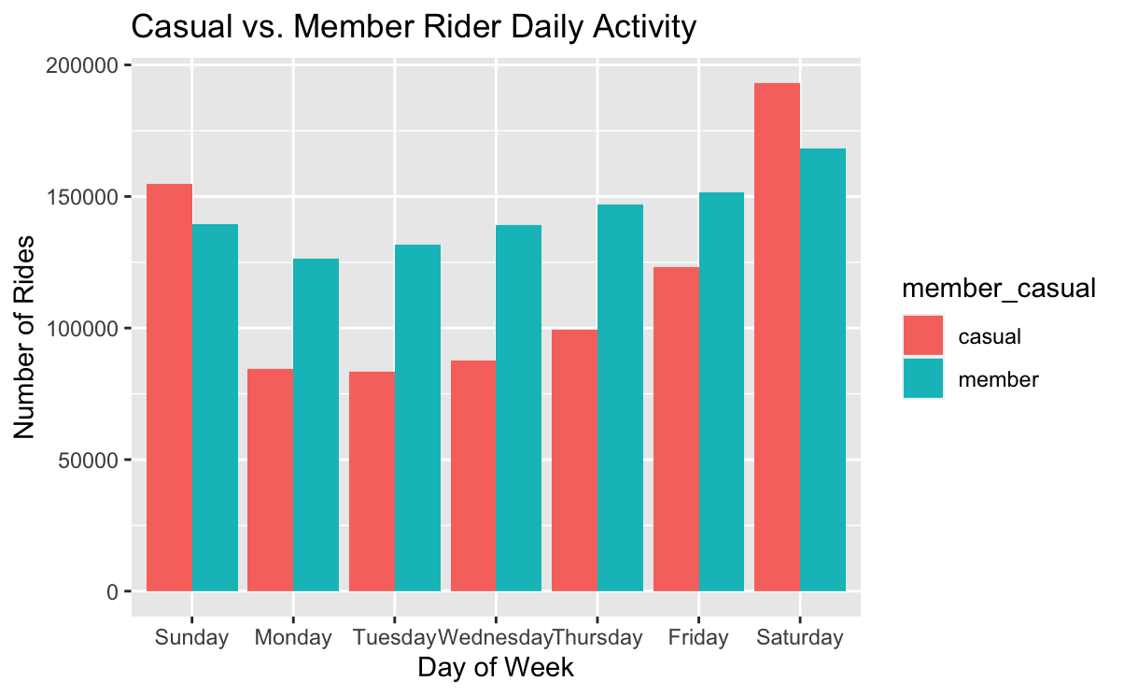
Casual riders ride more on Fridays, Saturdays, and Sundays.
Leisure rides are more present than commutes on weekends.
Members rent bikes on a more consistent basis throughout the entire week.
This is likely due to weekday commutes and weekend leisure trips.
Key takeaway: Casual riders dominate weekend activities
Table 1

Slide 5
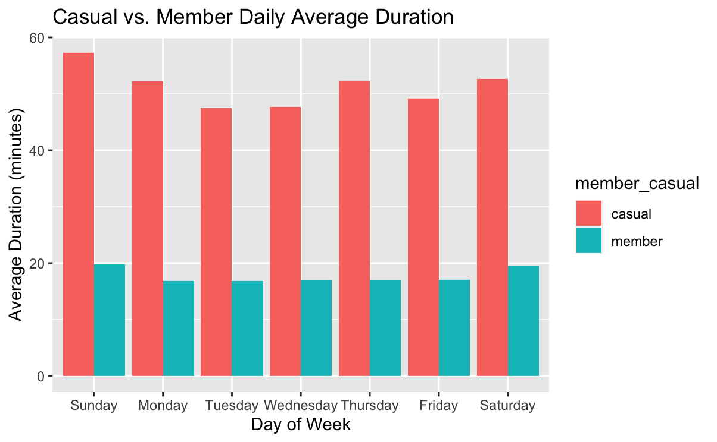
Overall, casual riders ride about 2.5-3x longer than members, corroborating casual riders ride for leisure rather than commuting.
Table 2

Slide 6
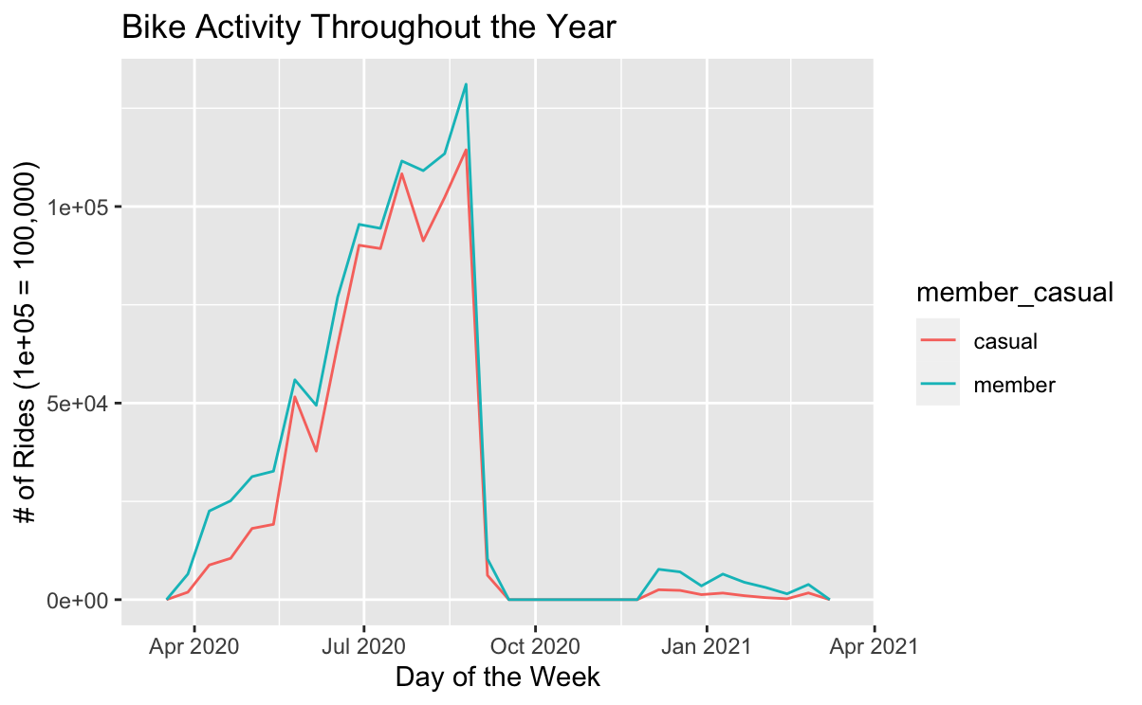
Rider activity picks up during the warmer seasons and drops during colder seasons due to freezing temperatures in the Chicago area
Key takeaway: Riders ride in spring, summer, and early fall.
Table 3

Slide 7
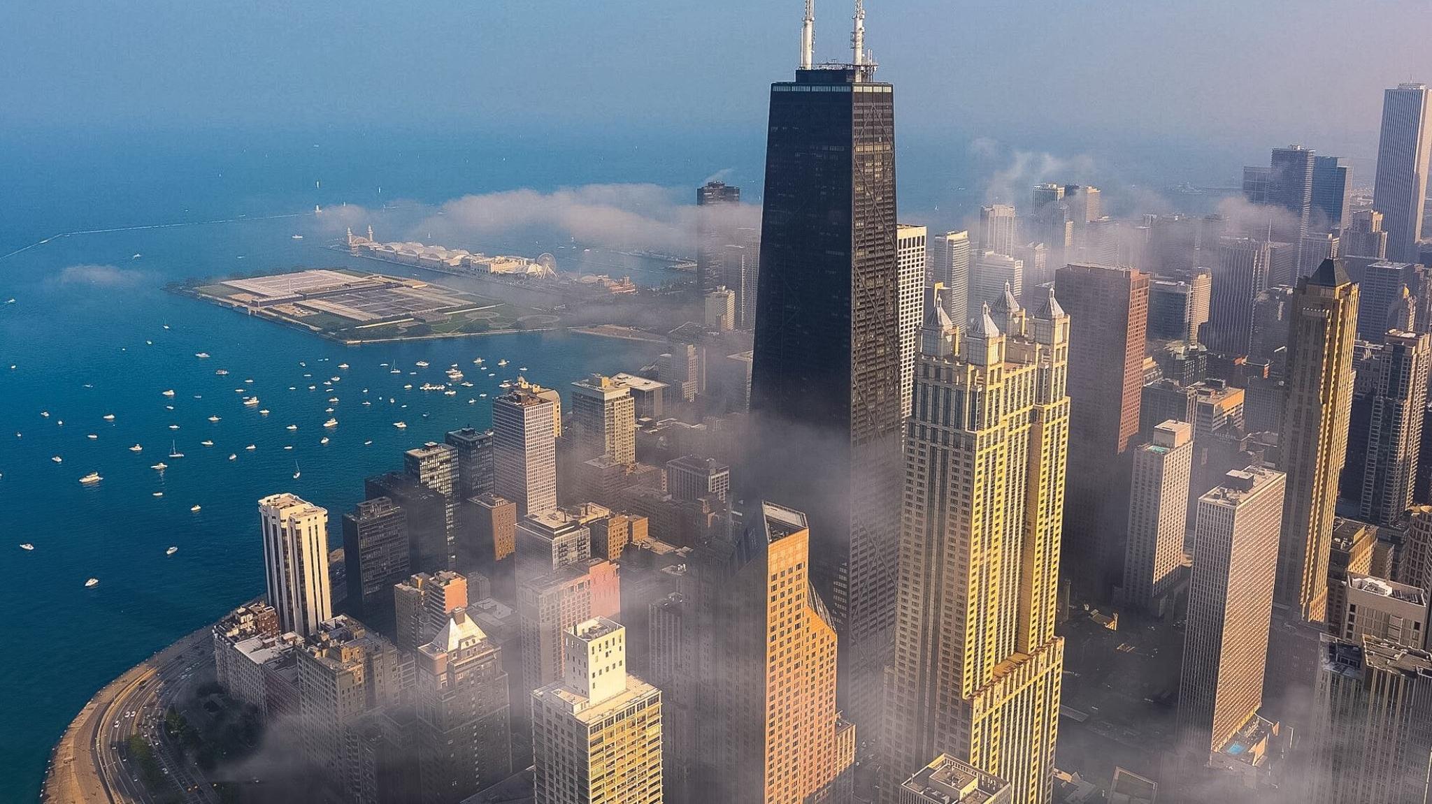
Recommendations
Create an annual weekend plan aimed at casual riders.
Casual riders use bikes for leisure (Table 1 & 2); an annual weekend plan would allow unlimited bike use on Fridays, Saturdays, and Sundays.
A lower annual rate would entice more casual customers to commit to an annual pass.

Slide 8

Recommendations
Run ads during spring and summer seasons when temperatures are warm and rider activity is high.
Chicago temperatures reach under 32 degrees throughout most of winter. Data shows bike activity is low when temperature are below freezing (Table 3).

Slide 9

Recommendations
Offer discounted annual membership in October for the following year.
Offering a discounted annual rate would help with forecasting of riders for the following year and maintaining customer loyalty while activity is low and freezing temperatures dominate the winter period (Table 3).

